Slide 1
Advanced Techniques with Large Language Models Lecture 2
Northeastern University
College of Engineering
Multidisciplinary Graduate Engineering Department
INFO 6105 – Fall 2024
Instructor: Abdolreza Mosaddegh

Slide 2
Regression Analysis
Regression analysis is used to:
Predict the value of a response variable based on the value of at least one explanatory variable
Explain the impact of changes in an explanatory variable on the response variable
Regression falls under supervised learning wherein the algorithm is trained with both input features and output variable.
Murder-rate= 2.56 poverty −29.91

Slide 3
Regression Analysis
Regression analysis is a statistical method used to model the relationship between a dependent variable (outcome) and one or more independent variables (features)
The dependent variable is typically an outcome, and the independent variables may contribute to predicting that outcome.
Used to determine how well the set of variables predict the dependent variable and which variables are significant predictors.
Salary = a*Working-Hours + b*Work-Experience + c*Education-Level + … + 2000
Dependent
Variable
Independent
Variables

Slide 4
Linear Regression
Fitting the data: finding the equation for the straight line (linear) that does the best job of modeling dependent variable as determined by independent variables.
Average-Income = b * College-Degree-Rate + a

Slide 5
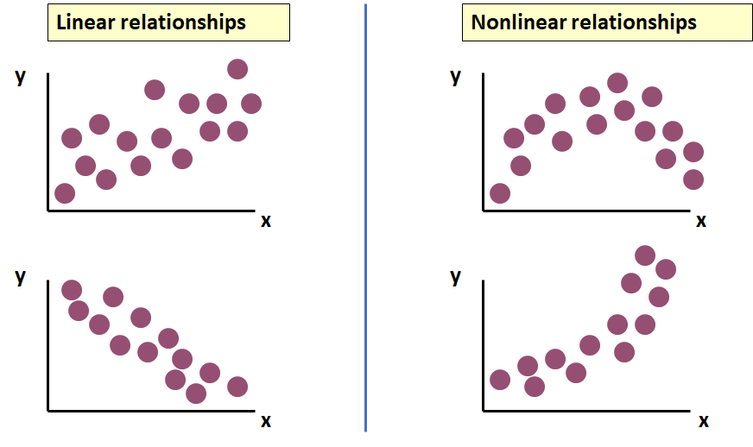
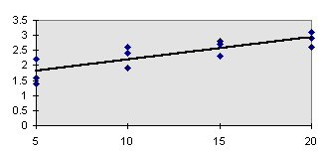
Linear Model
In Linear Regression, relationship between x and y is described by a straight line (y = bx + a).
Only linear relationships can be modeled using Linear Regression Model
Linear Regression

Slide 6
Simple Linear Regression - Terminology
“Regress X on Y” will mean to finding the equation for the straight-line fits best to training data on modeling Y based on X
Simple refers to the fact that there is a single independent variable in a linear relationship with the dependent variable
ŷ is the respective estimate of the y-value. This means that for each x-value the corresponding y-value is estimated.

Slide 7
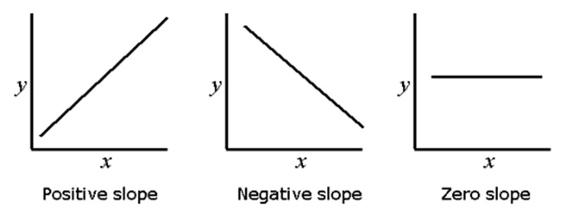
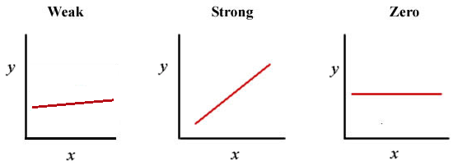
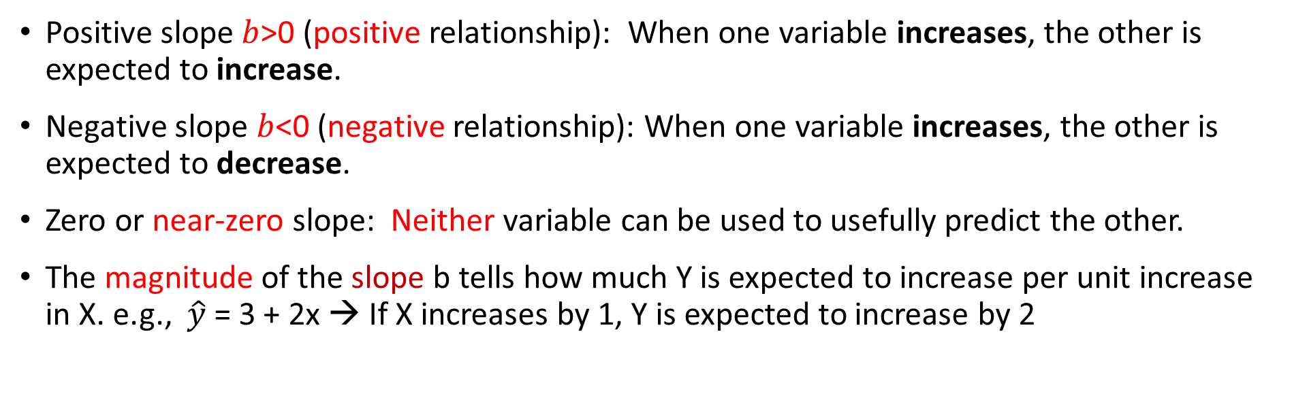
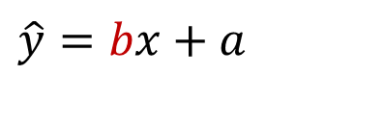
Interpreting the Slope (Reg Coefficient)
$$\hat{y}=bx+a$$
Positive slope $b$>0 (positive relationship): When one variable increases, the other is expected to increase.
Negative slope $b$<0 (negative relationship): When one variable increases, the other is expected to decrease.
Zero or near-zero slope: Neither variable can be used to usefully predict the other.
The magnitude of the slope b tells how much Y is expected to increase per unit increase in X. e.g., $\hat{y}$ = 3 + 2x → If X increases by 1, Y is expected to increase by 2

Slide 8
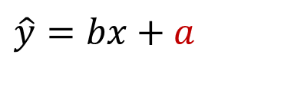
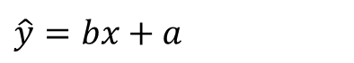
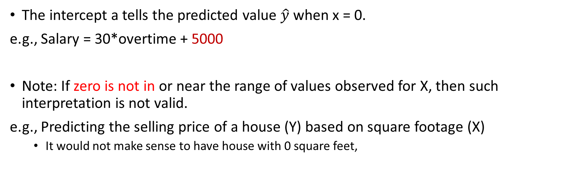
Interpreting the Intercept
$$\hat{y}=bx+a$$
The intercept a tells the predicted value $\hat{y}$ when x = 0.
e.g., Salary = 30*overtime + 5000
Note: If zero is not in or near the range of values observed for X, then such interpretation is not valid.
e.g., Predicting the selling price of a house (Y) based on square footage (X)
It would not make sense to have house with 0 square feet,
$$\hat{y}=bx+a$$
PRICE = 83*SQRFT + 12,510
Notes:
8

Slide 9
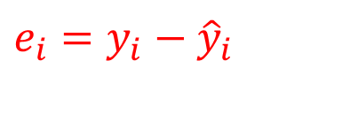
Residual
A residual (prediction error) is the difference between the observed value (𝒚) and the predicted value (𝒚 ̂) for each observation.
$$e_{i}=y_{i}−{\hat{y}}_{i}$$

Slide 10
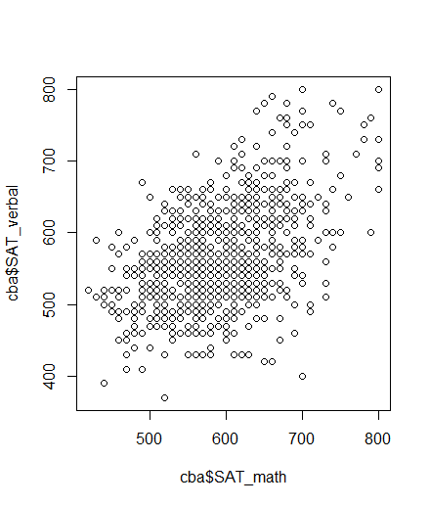
Problem Statement : Which Line is the Best Fit
There are many possible “fits”, which of these lines is the best?
A small residual means that the response variable is close to what it was predicted to be under the fitted regression model.
The target is to find a line fits to training data best, so we need to find the least total residuals.

Slide 11
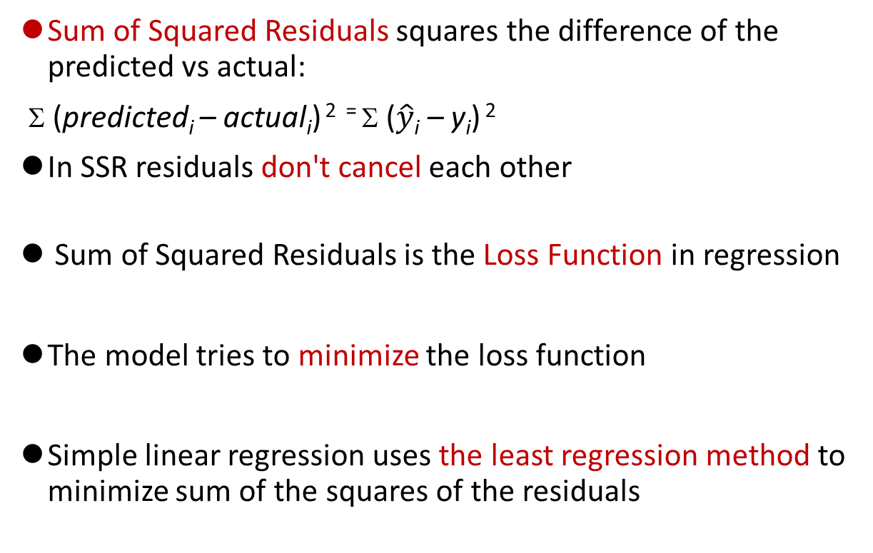
Some of Squared Residuals as Loss Function
Sum of Squared Residuals squares the difference of the predicted vs actual:
Σ (predicted_{i} – actual_{i}) ² ⁼ Σ ($\hat{y}$_{i} – y_{i}) ²
In SSR residuals don't cancel each other
Sum of Squared Residuals is the Loss Function in regression
The model tries to minimize the loss function
Simple linear regression uses the least regression method to minimize sum of the squares of the residuals
y
x
Notes:
Would choose middle 9+9 < 49

Slide 12
Bias vs Error
Bias is a systematic error that occurs due to inability of the model to fit training data. High bias indicates underfitting.
In a model with a low bias, average of error is near zero
In a model with a high bias, average of error is not zero and model is biased to higher or lower values

Slide 13
Approaches to Minimize SSR
The closed form for finding linear regression which is computationally expensive for large datasets.
There are also greedy approaches to estimate optimal weights with less computation cost.
One common greedy approach is gradient descendent.

Slide 14
Closed-form Method
ŷ = a + bx
SSR = Σ(y — ŷ)² = Σ(y — a — bx)²
To minimize SSR, we take the partial derivatives of SSR with respect to m and b, set them equal to zero, and solve for a and b.

Slide 15
Partial Derivative
SSR = Σ(y — a — bx)²
Taking the partial derivative of SSR with respect to b:
∂SSR/∂b = -2Σx(y — a — bx) = 0
Σxy — aΣx — bΣx² = 0
b = (Σxy — aΣx) / Σx²
Taking the partial derivative of SSR with respect to a:
∂SSR/∂a = -2Σ(y — a — bx) = 0
Σy — na — bΣx = 0
a = (Σy — bΣx) / n = 𝑦 ̄−𝑏𝑥 ̄

Slide 16
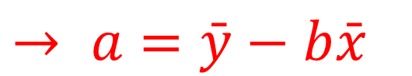
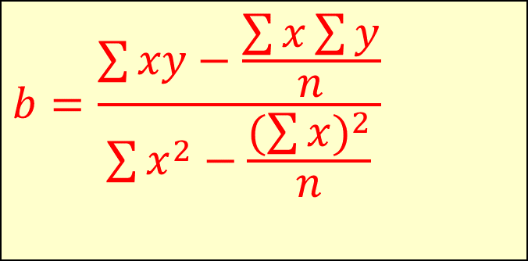
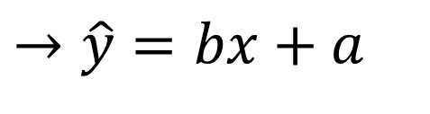
The Least Squares Equation
1) b = (Σxy — aΣx) / Σx²
2) a = (Σy — bΣx) / n
$$b=\frac{\sum{xy−\frac{\sum{x\sum{y}}}{n}}}{\sum{x^{2}−\frac{(\sum{x})^{2}}{n}}}$$
1,2 →
$$→ a=\bar{y}−b\bar{x}$$
$$→\hat{y}=bx+a$$

Slide 17
Regression Line Calculation - Example
Chemical reaction time based on mass

Slide 18
Regression Line Calculation - Example
 | Time | Mass
 | 5 | 40
 | 7 | 120
 | 12 | 180
 | 16 | 210
 | 20 | 240
Mean | 12 | 158

Slide 19
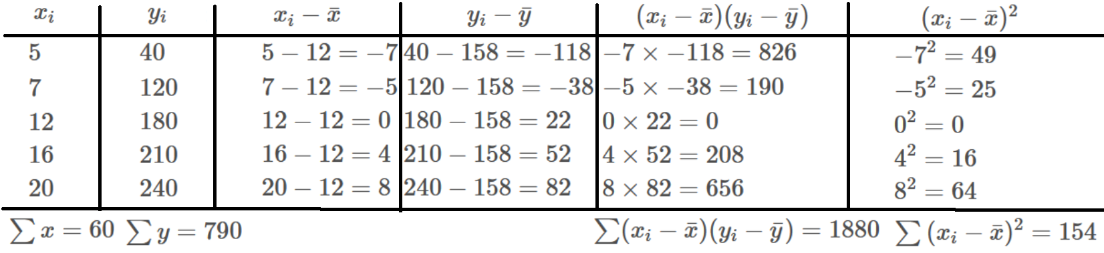
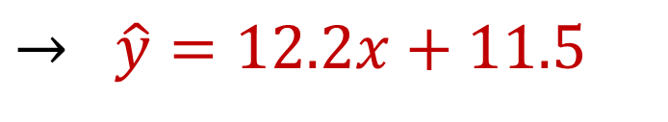
Regression Line Calculation - Example
$$→ \hat{y}=12.2x+11.5$$

Slide 20
Gradient Descent Approach
Gradient descent is a greedy optimization algorithm used to minimize the loss function of the model (SSR).
The derivative is called a gradient, which is the vector of partial derivatives with respect to each dimension of the input.
Iteratively subtract the gradient with respect to the model parameters (slope and intercept)
moves in the direction of the steepest ascent towards smaller loss

Slide 21
Gradient Descent - Intuitive
Zero slope of gradient → it is Minimum point (sometimes local minimum)
Big slope of gradient It→ is far from zero slope (which we are looking for) → we need bigger decrease
Small slope of gradient → It is near to zero slope → we need smaller decrease (not passing by)
1,2,3 → A greedy approach:
In each step, subtract a value proportional to last gradient (bigger value for big gradient and smaller value for small gradient) to get closer to minimum point.

Slide 22
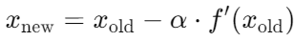
Learning Process
It starts with random initial numbers for parameters and iteratively updating the model’s parameters in the negative gradient direction.
In each iteration of the algorithm, the gradient of the cost function with respect to each parameter is computed.
The size of the step is controlled by the learning rate, which determines how quickly the algorithm moves towards the minimum.
The process is repeated until the cost function converges to a minimum, indicating that the model has reached the optimal set of parameters.

Slide 23

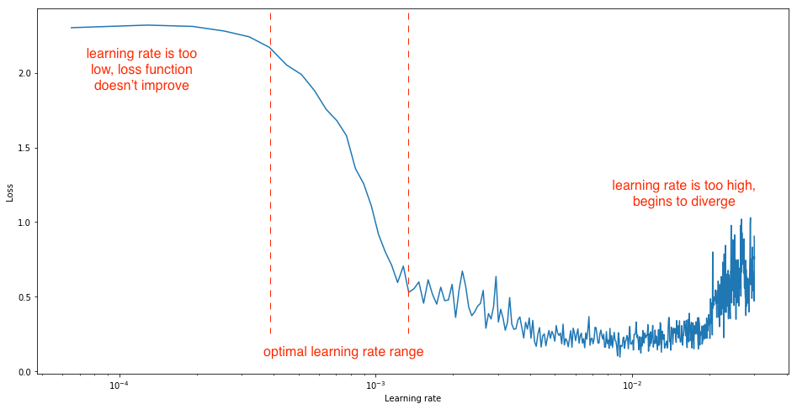
Learning Rate
Learning rate is a hyperparameter that determines how big a step is taken.
A too high learning rate will make the learning jump over minima
A too low learning rate will either take too long to converge or get stuck in a local minimum
Usually, optimal learning rate should be somewhere between 0.001 and 0.01 depends on optimization method

Slide 24
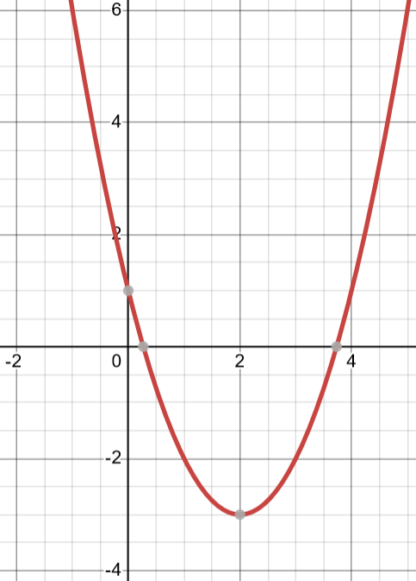
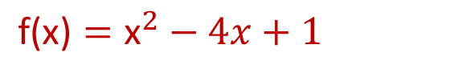
Gradient Descent – Example1
$$\text{f}\text{(}\text{x}\text{)}={\text{x}}^{2}−4x+1$$
Suppose that we want to find the x that minimize f(x):
(Minimum of the f(x) is -3 at x=2)
1- Calculate the derivative
The derivative (or gradient) of the function is: f′(x)=2x−4
2- Choose a starting point
Start at x0=9. (This is an initial guess for the minimum)
3- Choose a learning rate
learning rate α=0.1

Slide 25
Gradient Descent – Example1
4- Perform the gradient descent step
To update value of x, the formula is used:
Iteration 1:
Starting point: x0=9
f′(x)=2x−4 → Gradient at x0: f′(9)=2×9−4=14
Update x: x1= x0 – α*f′(x0) = 9 − 0.1×(14)=7.6

Slide 26
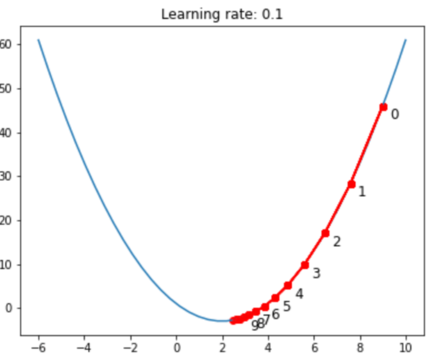
Gradient Descent – Example1
Iteration 2:
x1=7.6
f′(x)=2x−4 → f′(x1)=2(7.6)−4=15.2−4=11.2
Update x: x2= x1 – α*f′(x0) =7.6−0.1×11.2=7.6−1.12=6.48
Iteration 3:
x2=6.48
f′(x)=2x−4 → f′(x2)=2(6.48)−4=12.96−4=8.96
Update x: x3 = x2 – α*f′(x0) =6.48−0.1×8.96=6.48−0.896=5.584
Iteration 4:
x3=5.584
f′(x)=2x−4 → f′(x3)=2(5.584)−4=11.168−4=7.168
Update x: x4 = x3 – α*f′(x0) =5.584−0.1×7.168=5.584−0.7168=4.8672
Iteration 5:
x4=4.8672
f′(x)=2x−4 → f′(x4)=2(4.8672)−4=9.7344−4=5.7344
Update x: x5 = x4 – α*f′(x0) =4.8672−0.1×5.7344=4.8672−0.57344=4.29376

Slide 27
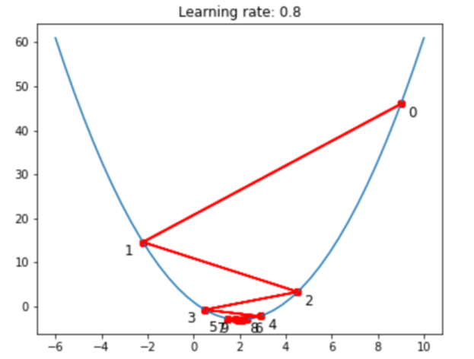
Gradient Descent – Example2
by taking a learning rate of 0.8 and starting point at x=9
Iteration 1:
Starting point: x0=9
f′(x)=2x−4 → Gradient at x0: f′(9)=2×9−4=14
Update: x1= x0 – a*f′(x0) = 9 − 0.8×(14)=-2.2
Iteration 2:
x1= -2.2
f′(x)=2x−4 → Gradient at x1: f′(-2.2)=2×-2.2−4= -8.4
Update: x2= x1 – a*f′(x1) = -2.2 − 0.8×(-8.4)= 4.52

Slide 28
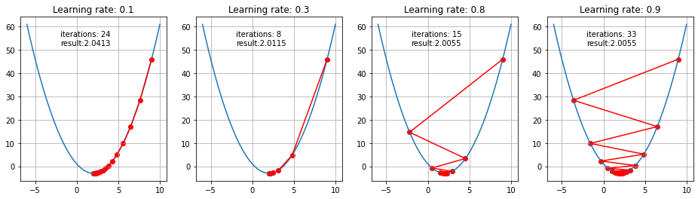
Effect of Learning Rate
First 10 steps taken by GD for small and big learning rates

Slide 29
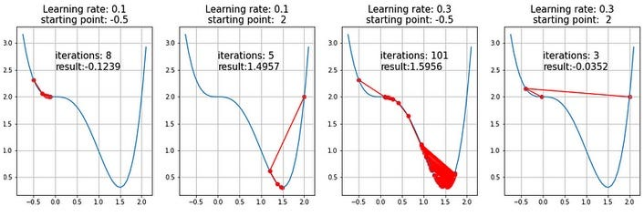
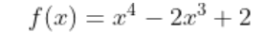
Saddle points
Existence of a saddle point imposes a challenge for the gradient descent algorithms and obtaining a global minimum is not guaranteed
Investigation of saddle points and how to escape from local optimum is a subject of ongoing studies and various solutions were proposed
A semi-convex function

Slide 30
Multiple Linear Regression
Explains a dependent variable using more than one independent variable
It evaluates the relative effect of independent variables on the dependent variable when holding all the other variables in the model constant.

Slide 31
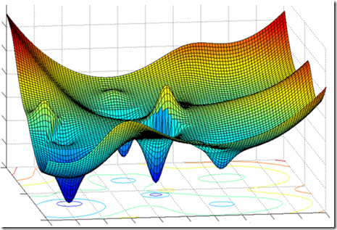
Gradient Descent in High Dimensional Data
In high-dimensional spaces (many features), gradient descent can struggle due to the "curse of dimensionality." The optimization landscape becomes more complex, making it harder for the algorithm to find the minimum efficiently.

Slide 32
Challenges of Gradient Descent
Saddle Points: These are points where the gradient is zero but are not a minimum. Gradient descent can get stuck at these points, leading to slow convergence or failure to find the optimal solution.
Plateaus: These are regions where the gradient is very small, causing the algorithm to make very slow progress. This can occur in highly non-linear and complex models, leading to inefficiencies.
Poor Initialization: The starting point of gradient descent (i.e., initial parameter values) can significantly affect the convergence. Poor initialization can lead to convergence to suboptimal minima or slow down the convergence process.
High Dimensionality: In high-dimensional spaces, gradient descent can struggle due to the "curse of dimensionality." The optimization landscape becomes more complex, making it harder for the algorithm to find the minimum efficiently.
Vanishing and Exploding Gradients: In deep learning, especially with deep neural networks, gradients can become very small (vanishing gradient) or very large (exploding gradient). This can lead to slow learning, instability, or failure in training the model effectively.

Slide 33
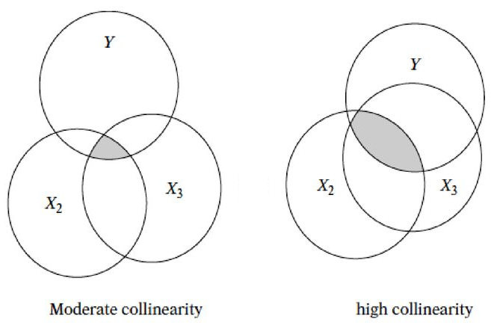
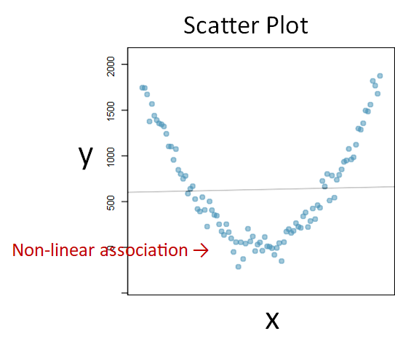
Conditions for regression
Assumptions of Regression
The chosen sample is representative of the population.
Linear association between dependent and independent variables
Independent variables are not highly correlated linearly (multicollinearity)
Constant variability of residuals (homoscedasticity)

Slide 34
Multicollinearity
In multicollinearity two or more independent variables are highly correlated with each other
Unstable Coefficient Estimates: The estimated coefficients may become highly sensitive to changes in the model or data.
Difficulty in Interpretation: When predictors are highly correlated, it becomes challenging to interpret the effect of each predictor on the dependent variable since their effects are intertwined.
Tis a high correlation between x₁ and x₂, then it is difficult to determine b₁ and b₂. If both are e.g. completely equal, the regression model does not know how large b₁ and b₂ should be, becoming unstable.

Slide 35
Addressing Multicollinearity
Compute the correlation matrix of independent variables to detect high correlations (e.g., above 0.7)
Remove or Combine Highly Correlated Predictors:
Remove one of each pair of highly correlated variables
Use feature reduction techniques like PCA to transforms the variables into a set of uncorrelated variables
3. Sometimes increasing the size of training data can help to decrease the impact of multicollinearity.

Slide 36
Correlation Coefficient
Correlation coefficient (Pearson):
$$r=\frac{\sum{(x−\bar{x})(y−\bar{y})}}{\sqrt{[\sum{(x−\bar{x})^{2}][}\sum{(y−\bar{y})^{2}]}}}$$
or the algebraic equivalent:
$$r=\frac{n\sum{xy−\sum{x\sum{y}}}}{\sqrt{[n(\sum{x^{2})−(\sum{x)^{2}][n(\sum{y^{2})−(\sum{y)^{2}]}}}}}}$$
where:
r = Sample correlation coefficient
n = Sample size
x = Value of the explanatory variable
y = Value of the response variable

Slide 37
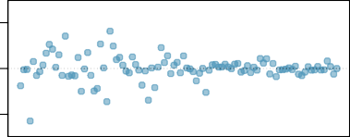
Heteroscedasticity
Variance of the residuals is not constant across all levels of the independent variables because:
Important predictor variables are left out of the model
The relationship between the independent and dependent variables may not be linear
The variability of the dependent variable increases with its mean. For example, in financial data, high-value investments might have more variability in returns compared to low-value investments, leading to heteroscedastic residuals.
Outliers or extreme values in can dependent variable disproportionately influence the variance of residuals
Etc.
−2000 0 2000
Residuals
Residuals range changes as x gets large
x

Slide 38
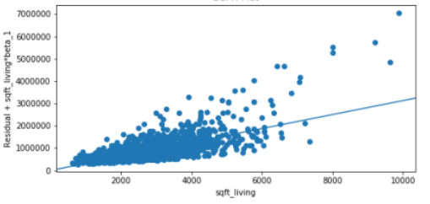
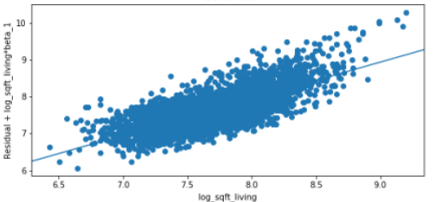
Addressing Heteroscedasticity
Using data preprocessing to remove outliers and noises
Adding omitted variables or modify variables
Using non-linear model if the relationships between dependent and independent variables is not linear
Apply transformations that stabilize variance of dependent variables
E.g., log transformation

Slide 39
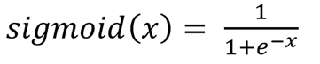
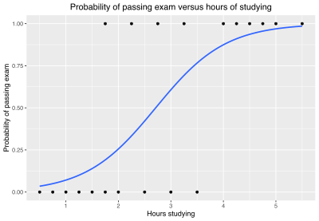
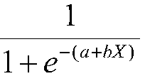
Logistic Regression
Uses Sigmoid function
Produces a number between 0 and 1
Single-Variate Logistic Regression
y = Sigmoid (bX + a) =
Multivariate Logistic Regression
y = Sigmoid (β₀ + β₁x₁ + β₂x₂+… β_{n}x_{n})

Slide 40
Binary Classification
The type of dependent variable determines the type of regression, linear or logistic. When outcome of interest is dichotomous logistic regression is used.
Logistic regression can be used for binary classification as it produces a value between 0 and 1
The output of the logistic function is interpreted as the probability that a given input x belongs to the positive class. The model predicts the probability P(Y=1∣x) and classifies the input based on a threshold.
For two classes, if the value is greater than 0.5 (threshold value) then it belongs to Class 1 otherwise it belongs to Class 0.

Slide 41
Logistic Regression - Example
Predict spam (label) emails using the following features:
Feature 1: Number of times the word "free" appears in the email
Feature 2: Number of times the word "win" appears in the email
Suppose after training, the model gives us the following equation:
Spam = Sigmoid (0.5×Free Count+0.8×Win Count−1.0)
Free Count | Win Count | Spam (Label)
3 | 1 | 1
0 | 0 | 0
1 | 2 | 1
0 | 1 | 0
2 | 3 | 1

Slide 42
Logistic Regression - Example
Probability(Spam ∣ Free Count, Win Count)= Sigmoid (0.5×Free Count+0.8×Win Count−1.0)
To classify new emails, we can use the trained model:
Probability(Spam∣2,1)= Sigmoid(0.5×2+0.8×1−1.0) = Sigmoid (1.6) ​≈0.832
Since 0.832 is greater than 0.5, the model classifies the email as spam.
Probability(Spam∣1,0)= Sigmoid(0.5×1+0.8×0−1.0) = Sigmoid (-0.5) ​≈0.377
Since 0.377 is less than 0.5, the model classifies the email as not spam.
Free Count | Win Count | Spam (Label)
2 | 1 | ?
1 | 0 | ?

Slide 43
Artificial Neuron
Artificial Neuron is the building block of artificial neural networks
It is designed to mimic the way biological neurons in the human brain process information and learn from data.
Biological Neurons
Artificial Neurons
Information is conveyed by mean firing rate of neuron (activations as a series of brief electrical pulses )

Slide 44
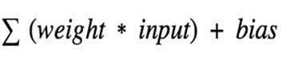
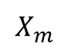
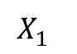
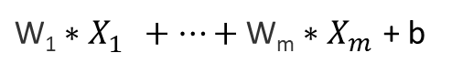
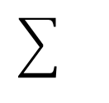
A Single Artificial Neuron
Inputs Weights Bias Activation Function Outputs
b
$$X_{1}^{}$$
w1
${\text{W}\text{1}∗X}_{1}^{}+…+\text{W}\text{m}∗X_{m}^{}$ + b
…
…
A
O
$$X_{m}^{}$$
wm
An artificial neuron creates output using two components:
(1) weighted sum of inputs plus a bias
(2) activation function.
Weights and bias represent a linear function on inputs
Using Activation function it decides whether it should be activated (fired) or not (e.g., output of 1 as activated and 0 as not activated).

Slide 45
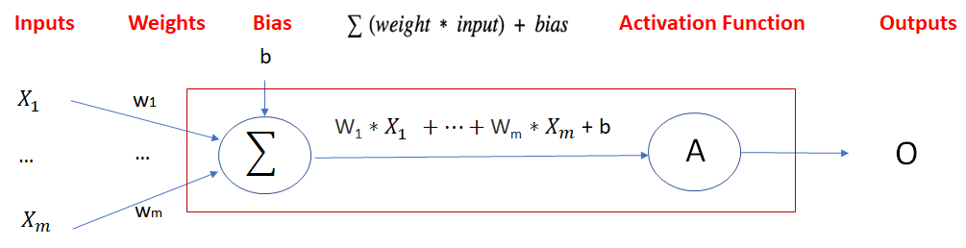
Activation Function
Most of real-world relationships are non-linear
Without activation function, the output would be a polynomial linear function with less power to learn complex patterns comparing non-leaner functions
Non-Linear activation functions can learn complex relationships between the inputs and response and approximate a wide range of functions
There are several non-linear activation functions in neural networks

Slide 46
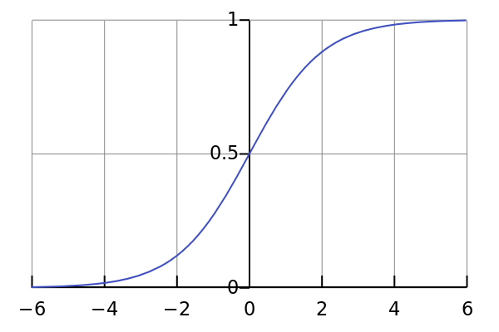
Activation Functions - Sigmoid
It is nonlinear in nature. Combinations of this function are also nonlinear
the output of the activation function is always going to be in range (0,1)
Sigmoid functions can be used in binary classification (> 0.5 is 1 else 0)

Slide 47
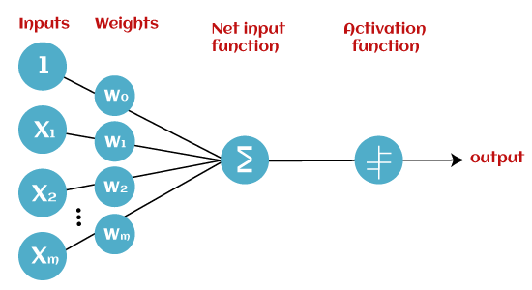
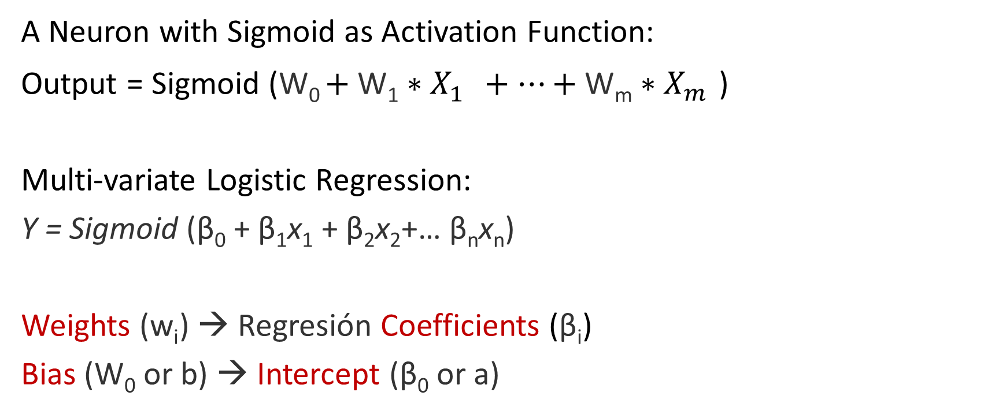
Logistic Regression as a Neuron with Sigmoid
A Neuron with Sigmoid as Activation Function:
Output = Sigmoid (W₀ $+ {\text{W}\text{1}∗X}_{1}^{}+…+\text{W}\text{m}∗X_{m}^{}$ )
Multi-variate Logistic Regression:
Y = Sigmoid (β₀ + β₁x₁ + β₂x₂+… β_{n}x_{n})
Weights ($\text{w}\text{i}$) → Regresión Coefficients (β_{i})
Bias (W₀ or b) → Intercept (β₀ or a)

Slide 48
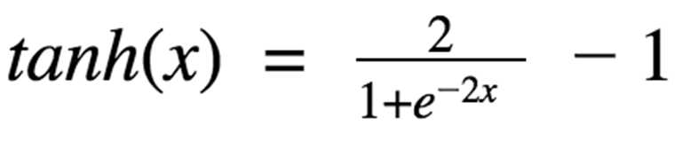
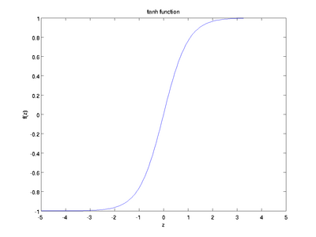
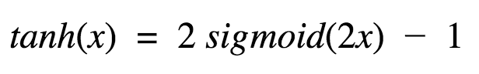
Activation Functions - Tanh
The output of the activation function is always going to be in range (-1,1)
Tanh is also a widely used non-linear activation function, especially in time series data
This looks very similar to sigmoid. In fact, it is a scaled sigmoid function

Slide 49
Sigmoid vs Tanh
Sigmoid: More prone to the vanishing gradient
The sigmoid function has a gradient that can become very small when the input values are large (positively or negatively), which can lead to the vanishing gradient problem. This issue can significantly slow down training in deep networks because the gradient diminishes as it propagates back through layers, leading to very small weight updates.
Tanh: Less prone to the vanishing gradient
The tanh function also suffers from the vanishing gradient problem, but to a lesser extent than the sigmoid function. This is because the gradients of the tanh function are stronger around the origin, where the function is steeper.

Slide 50
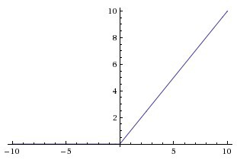
Activation Functions - ReLu
The output of the activation function is always going to be in range (0,inf)
ReLu is non-linear in nature and combinations of ReLu are also non-linear
Using a sigmoid or tanh will cause almost all neurons to activate, but in ReLu almost 50% of the network yields 0 activation because of the characteristic of ReLu. This means the network is lighter.
ReLu is less computationally expensive than tanh and sigmoid because it involves simpler mathematical operations.
ReLu(x) = max(0,x)

Slide 51
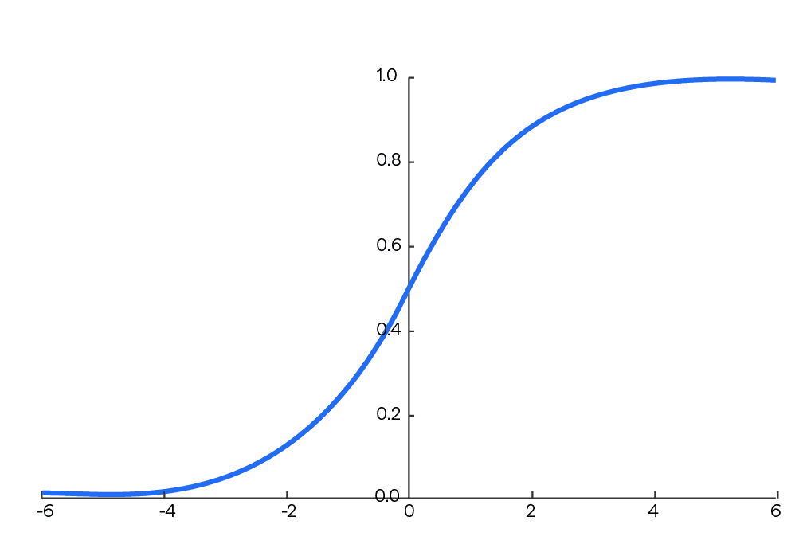
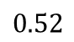



Activation Functions - Softmax
The output of the activation function is always going to be in range (0,1)
Divides by the sum of all outputs, allows for probability distribution.
Useful for multi-class classification problems.
$$\text{Softmax}(x)=\frac{e^{x_{i}}}{\sum_{k=1}^{K}{e^{x_{k}}}}$$
Sigmoid
Softmax
$$0.78$$
Class1
Class1
$$0.65$$
Class2
Class2
$$0.52$$
Class3
Class3

Slide 52
Selection of Activation Function
When you know the function you are trying to approximate has certain characteristics, you can choose an activation function which will approximate the function faster leading to faster training process.
Sigmoid can be used for the output layer in binary classification.
Softmax is usually used for the output layer in multi-class classification.
Sigmoid, Tanh and ReLU can be used for hidden layers.
ReLU works most of the time as a general approximator in hidden layers
There are also many other activation functions such as Leaky ReLU, etc. can be used to address different issues in Neural Networks

Slide 53
Training – Problem Statement
Training is to find weights and biases in a way that produce best outputs.
The goal is to minimize the error / cost between the predicted and real (target) outputs and we need a metric to quantify this error (loss).
Loss function compares the real outputs (target) and predicted output values.
Regression Loss Functions: used in regression neural networks; given an input, the model predicts a corresponding continuous value (rather than classes). Example: Sum Squared Error, Mean Squared Error
Classification Loss Functions: used in classification neural networks; given an input, the neural network produces probabilities of belonging to various classes (categories). The class with the highest probability of belonging can be selected as the predicted class.
Examples: Binary Cross-Entropy (Binary Classification),
Categorical Cross-Entropy (Multi-class Classification)

Slide 54

Loss Function
There are many measures to quantify this error and one of the most popular measure is Sum of Squared Errors. For a single output SSE can be defined as:
In SSE positive and negative differences between predicted output and real output don’t cancel each other
$$E= (Real Label−Output of Neural Network)^{2}$$
To facilitate derivative operations, we can also use:
$E= \frac{1}{2}(Real Label−Output of Neural Network)^{2}$ $= \frac{1}{2}(Y−O)^{2}$

Slide 55

Training of a Single Neuron
Given one training sample containing features ($x_{1}{,x}_{2}, …{,x}_{n})$ and real output($y$)
Compute the output of the model (O)
Calculate error / cost using a loss function
there are different ways to define loss. The following is an example:
$$E=\frac{1}{2}(y−O)^{2}$$
Update the weights and biases in a way that minimizes the error / loss

Slide 56






Minimizing Error
We can find a weight Wi which minimize Error using partial derivative of $\frac{∂E}{∂w_{i}}$
$$E=\frac{1}{2}(y−O)^{2}$$
Error
$Slope of Curve=\frac{∂Error}{∂w_{1}}$
$Slope of Curve=\frac{∂Error}{∂w_{1}}$ = 0
Usually we need to minimize error against more than one para𝑚𝑒𝑡𝑒𝑟
W1

Slide 57



Gradient Descent
Gradient descent is a greedy iterative optimization algorithm that is used to approximate the optimized weights which minimize the loss function.
The goal is then to minimize the error by iteratively moving downwards using a step size (Learning Rate).
$$w_{}=w_{}−Learning rate∗\frac{∂E}{∂w_{}}$$

Slide 58






Training of a Single Neuron - Example
b=0
$X_{1}$=0
$w_{1}$=0
$s=X_{1}w_{1}$+$X_{2}w_{2}+b$ = 0
∑
Sigmoid
O=Sigmoid(0)=0.5
Activation function
$$X_{2}=1$$
$w_{2}$=0
Consider training data with features ($X_{1}$=0, $X_{2}=1$), and real output of Y=0.
Then $: O=Sigmoid\left(0∗1+0∗0+0\right)=Sigmoid\left(0\right)=0.5$
E=$\frac{1}{2}(Y−O)^{2}= \frac{1}{2}(0−0.5)^{2}=0.125$
To reduce the error, we need to find W1,W2, and b which minimize loss

Slide 59




Update Weights
$W_{i}$ = $W_{i}$ - Learning_Rate* $\frac{∂E}{∂W_{i}}$
The chain rule is a formula that expresses the derivative as :
$\frac{dz}{dx}=\frac{dz}{dy}\frac{dy}{dx}$
Therefore:
$$\frac{∂E}{∂W_{1}}=\frac{∂E}{∂O}\frac{∂O}{∂s}\frac{∂s}{∂W_{1}}$$
$$\frac{∂E}{∂W_{2}}=\frac{∂E}{∂O}\frac{∂O}{∂s}\frac{∂s}{∂W_{2}}$$
$\frac{∂E}{∂b}=\frac{∂E}{∂O}\frac{∂O}{∂s}\frac{∂s}{∂b}$
$s=X_{1}w_{1}$+$X_{2}w_{2}+b$
O = Sigmoid(s)
E=$\frac{1}{2}(Y−O)^{2}$

Slide 60


Training of a Single Neuron - Example
$\frac{∂E}{∂W_{1}}=\frac{∂E}{∂O}\frac{∂O}{∂s}\frac{∂s}{∂W_{1}}$
$\frac{∂E}{∂O}$ = $\frac{∂(\frac{1}{2}(Y−O)^{2})}{∂O}=2∗\frac{1}{2}\left(−1\right)\left(Y−O\right)=O−Y=0.5 −0=0.5$
$\frac{∂O}{∂s}$ = $\frac{∂(sigmoid\left(s\right))}{∂s}$ = sigmoid(s) (1-sigmoid(s)) = 0.5 (1 - 0.5) = 0.25
$\frac{∂s}{∂W_{1}}$ = $\frac{∂{(X}_{1}w_{1}\text{+}X_{2}w_{2}+b)}{∂W_{1}}= X_{1}$ = 0
$\frac{∂E}{∂W_{1}}=\frac{∂E}{∂O}\frac{∂O}{∂s}\frac{∂s}{∂W_{1}}=0.5∗0.25∗0 = 0$
Now we can update $w_{1}$:
$w_{1}new=w_{1}old−rate∗\frac{∂E}{∂W_{1}}$ = 0 – 0.1*0 = 0
$s=X_{1}w_{1}$+$X_{2}w_{2}+b$
O= Sigmoid(s)
𝐸 $= \frac{1}{2}(Y−O)^{2}$
$X_{1}$=0, $X_{2}=1$, Y=0
O= 0.5
Assume rate is 0.1

Slide 61

Training of a Single Neuron - Example
$\frac{∂E}{∂W_{2}}=\frac{∂E}{∂O}\frac{∂O}{∂s}\frac{∂s}{∂W_{2}}$
$\frac{∂E}{∂O}$ = $\frac{∂(\frac{1}{2}(Y−O)^{2})}{∂O}=O−Y=0.5 −0=0.5$
$\frac{∂O}{∂s}$ = $\frac{∂(sigmoid\left(s\right))}{∂s}$ = Sigmoid(s) (1-Sigmoid(s)) = 0.5 (1-0.5) = 0.25
$\frac{∂s}{∂W_{2}}$ = $\frac{∂{(X}_{1}w_{1}\text{+}X_{2}w_{2}+b)}{∂W_{2}}= X_{2}$ = 1
$\frac{∂E}{∂W_{2}}=\frac{∂E}{∂O}\frac{∂O}{∂s}\frac{∂s}{∂W_{2}}=0.5∗0.25∗1=0.125$
Now we can update $w_{2}$:
$w_{2}new=w_{2}old−rate∗\frac{∂E}{∂W_{2}}$ = 0 – 0.1*0.125 = -0.0125
$s=X_{1}w_{1}$+$X_{2}w_{2}+b$
O= Sigmoid(s)
𝐸 $= \frac{1}{2}(Y−O)^{2}$
$X_{1}$=0, $X_{2}=1$, Y=0
O= 0.5
Assume rate is 0.1

Slide 62

Training of a Single Neuron - Example
$\frac{∂E}{∂b}=\frac{∂E}{∂O}\frac{∂O}{∂s}\frac{∂s}{∂b}$
$\frac{∂E}{∂O}$ = $\frac{∂(\frac{1}{2}(Y−O)^{2})}{∂O}=O−Y=0.5 −0=0.5$
$\frac{∂O}{∂s}$ = $\frac{∂(sigmoid\left(s\right))}{∂s}$ = Sigmoid(s) (1-Sigmoid(s)) = 0.5 (1-0.5) = 0.25
$\frac{∂s}{∂b}$ = $\frac{∂{(X}_{1}w_{1}\text{+}X_{2}w_{2}+b)}{∂b}=$ 1
$\frac{∂E}{∂b}=\frac{∂E}{∂O}\frac{∂O}{∂s}\frac{∂s}{∂b}=0.5∗0.25∗1=0.125$
Now we can update $w_{2}$:
b$_new=b_old−rate∗\frac{∂E}{∂b}$ = 0 – 0.1*0.125 = -0.0125
$s=X_{1}w_{1}$+$X_{2}w_{2}+b$
O= Sigmoid(s)
𝐸 $= \frac{1}{2}(Y−O)^{2}$
$X_{1}$=0, $X_{2}=1$, Y=0
O= 0.5
Assume rate is 0.1

Slide 63






Training of a Single Neuron - Example
b=-0.0125
$X_{1}$=0
$w_{1}$=0
∑
$s=X_{1}w_{1}$+$X_{2}w_{2}+b=−0.025$
Sigmoid
O=Sigmoid($−0.025$)=0.4
$$X_{2}=1$$
$w_{2}$=-0.0125
Activation function
$$w_{1}\text{=0}\text{,}{ w}_{2}\text{=−0.0125}\text{, }\text{b}\text{=−0.0125 }\text{Then}: O=Sigmoid\left(0∗0+1∗−0.0125− 0.0125\right)=Sigmoid\left(−0.025\right)=0.4$$
$$\text{E}\text{=} \frac{1}{2}(Y−O)^{2}= \frac{1}{2}(0−0.4)^{2}=0.08$$
This process is repeated until the loss is sufficiently small (below a threshold) or a maximum number of iteration is reached or there is no significant decrease in loss.
Gradient descent can get stuck in the local optimal, therefore, sometimes the results are not globally optimal.

Slide 64

Assignment 2
Split dataset into training (75%) and test (25%) data
Train a multi-variate logistic regression on training data with ‘Heart_Attack’ as outcome (dependent variable) and all other attributes as features (Independent variables).
Calculate accuracy of the model for test data.

